Slide 1
ARGUMENTATIVE WRITING
Do I know the components of argumentative writing?

Slide 2
Is your writing PARALLEL?
Warm-up
Sometimes lists contain a series of words or phrases. In these cases, the words or phrases should have a similar form. In other words, they should be parallel. Look at the following examples:
Not Parallel: My mom likes to recycle, reusing, and refurbishes old things.
Parallel: My mom likes recycling, reusing, and refurbishing things around our house.
Notice how the form of the word was the same in the correct sentence. The consistent use of the -ing ending clarifies the meaning and draws attention to the action.

Slide 3
MAKE THE FOLLOWING SENTENCES PARALLEL
Warm-up
Complete the sentences with parallel words and/or phrases. Write the correct answer on the line.
a. Collecting recyclable trash and ____________ the water bottles are included in Simon’s jobs as waste management leader. [also to refill / refilling / refill]
b. Sweat poured off her face, ran down her neck, and _____________________ as Cheyenne focused intently on picking up trash in her neighborhood. [soaked her shirt / was soaking her shirt / did soak her shirt]
c. “My idea of a good time is to ___________ up the back of the car with junk on a Saturday morning and ______________ it to the dump” (Rooney). [loading; taking / load; take / then load; to take]

Slide 4
Standards
ELAGSE7RI1: Cite several pieces of textual evidence to support analysis of what the text says explicitly as well as inferences drawn from the text.
ELAGSE7RI8: Trace and evaluate the argument and specific claims in a text, assessing whether the reasoning is sound and the evidence is relevant and sufficient to support the claims.
ELAGSE7W1: Write arguments to support claims with clear reasons and relevant evidence
LEARNING TARGET - Examine the essential components and organizational structure of a successful essay of argumentation.

Slide 5
What goes in the conclusion?
The conclusion paragraph is important, as it must close the issue by showing that the topic has been covered thoroughly. It can also include a call to action, which is an idea about what people can do about the topic, how people can be warned about the topic, or how they can benefit from the position argued.
Begin by paraphrasing the thesis statement or claim.
Then, present one or two sentences that summarize the reasons and evidence.
Finally, provide a benefit that will result from complying with or heeding the argument. Or provide a call to act to move the audience into wanting to make change.

Slide 6
Let’s look at an example
Year round school is the answer to the economic and educational problems in the United States.
A year round schedule will prevent students from losing the hard earned knowledge gained during the school year.
The nation’s future depends upon having intelligent citizens. Schools must be year round in order to graduate such citizens.
Rephrased thesis
Summarized reasons
Benefit/call to action

Slide 7
To Chew or Not To Chew
Lets identify elements of argumentative essay.
Notes:
Copy pages 2-3 from the SB attachment. Project the essay(attached word document) on the whiteboard. Start as a class identifying the elements in the first and/or second paragraph. Have students complete the remaining parts. You might want to list those parts. Have students answer the guided question for homework.

Slide 8
Independent Reading
10 minutes
Congratulations Jalyn
12 rounds is fantastic!

Slide 9
Wednesday warmup
Parallel Lists with Clauses
A clause is a word group that contains both a subject and a verb. Clauses can stand alone when they express a complete thought (independent clause) or they can need another clause to help them make sense (dependent clause). Sometimes a sentence can contain a series of clauses. In these cases, the clauses should be written in parallel form.
Not Parallel: The sanitation workers were told that long sleeves would protect their skin, goggles would protect their eyes, and to use dust masks to protect their throat and lungs.
Parallel: The sanitation workers were told that long sleeves would protect their skin, goggles would protect their eyes, and dust masks would protect their throat and lungs.

Slide 10
Rewrite the clause
In 1031, the Japanese began to recycle and then repulped their paper.
Today, neighborhoods are filled with dark green cans for trash and bright blue cans in order for people to be able to recycle.

Slide 11
Punctuation Rules
Use a comma to separate items in a series. For logic and consistency, it is helpful to include a final comma (called a serial, or Oxford, comma) before the conjunction; however, it is usually not incorrect to omit it.
Ex :Andrew A. Rooney also says, “Prosperity in the United States is based on using things up as fast as we can, throwing away what’s left, and buying new ones.
Use a semicolon to join items in a series when the items themselves include commas.
Ex: My parents had their first meeting on April 3, 1992; their first conversation on April 27, 1992;and their first date on April 30, 1992

Slide 12
Parallel structure – Write Wednesday
Read the sample student response and make corrections to create parallel structure. Add the necessary punctuation to the paragraph.
[1] Sometimes it’s hard to think about the results of recycling or not to recycle because we only see the immediate effects of our choices. [2] However, this should be a reason to care about recycling. [3] We are preparing the world where our grandkids will live and hope that it will be better. [4] My mom won’t let me keep food in my room because she knows that it will cause a bug infestation. [5] It’s the same with recycling. [6] Since we know what will happen if we don’t start taking care of our trash, we should do all we can to stop our own “infestation.”

Slide 13
Thursday warm up
READ AND WRITE the example of a claim below. Mark the claim by underlining its subject (usually nouns) and circling its opinion (words with strong connotations) and by number the reasons to be developed.
Claim: There are numerous downsides to year-round schooling; it has no positive effects on education, it adds to the cost, and it disturbs the long-awaited summer vacation.

Slide 14
Learning targets
Identify a writer’s use of counterclaims and rhetorical appeals and analyze their effectiveness.
Compare and contrast a written speech to a film or audio version.

Slide 15
WORK PERIOD – RHETHORIC
is the art of using words to persuade in writing or speaking. Writers find interesting ways to use just the right words that appeal to their audience in order to convince them.
Rhetorical appeals can strengthen an argument by appealing to logic (logos), emotions (pathos), or a sense of right and wrong (ethos).
Logos is one of the most important appeals in an effective argument because of its use of facts and logic to build relevant and valid reasoning.
THE GREAT DEBATERS

Slide 16
WORK PERIOD CONTINUED
Just the Right Rhetoric: Logical Appeals
In your Springboard textbook turn to Activity 2.13
Read/listen to each speech written and given by women
Identify a writer’s use of counterclaims and rhetorical appeals and analyze their effectiveness.
Compare and contrast a written speech to a film or audio version.
As you read the speeches, mark the text with “L” for logos when you notice a statistic, fact, or example.
Circle unknown words and phrases. Try to determine the meaning of the words by using context clues, word parts, or a dictionary.

Slide 17
Common Assessment
Friday
Parallel structure

Slide 18
WORK PERIOD CONTINUED
Just the Right Rhetoric: Logical Appeals
In your Springboard textbook turn to Activity 2.13
Read/listen to each speech written and given by both women
Identify a writer’s use of counterclaims and rhetorical appeals and analyze their effectiveness.
In the margins of the book make a note of which rhetorical devices (logos, ethos, and/or pathos) are used and where they are in the speeches. You need to identify at least 5 examples of these rhetorical devices. You must have at least one example of each: logos, ethos, and pathos.
Circle unknown words and phrases. Try to determine the meaning of the words by using context clues, word parts, or a dictionary.

Slide 19
WORK PERIOD CONTINUED
Just the Right Rhetoric: Logical Appeals
In your Springboard textbook turn to Activity 2.13
Read/listen to each speech written and given by both women
Identify a writer’s use of counterclaims and rhetorical appeals and analyze their effectiveness.
As you read the speeches, mark the text with “L” for logos when you notice a statistic, fact, or example.
Circle unknown words and phrases. Try to determine the meaning of the words by using context clues, word parts, or a dictionary.

Slide 20
In what ways do the characters remind you of yourself, a family member, or a friend? Explain.

Slide 21
Quick-write
What’s the difference between a opinion and an claim?
Notes:
Copyright © 2018 Jeanne Wolz, www.teacheroffduty.com. For classroom use only by a single teacher. Please purchase one licensure per teacher using this product. All rights reserved.

Slide 22
Quick-write:
How do you think making a good argument is like riding a rollercoaster?
Notes:
Copyright © 2018 Jeanne Wolz, www.teacheroffduty.com. For classroom use only by a single teacher. Please purchase one licensure per teacher using this product. All rights reserved.

Slide 23
Philosophical Chairs
Two sides of the room: disagree to the left, agree to the right
Not sure? Middle
One person speaks at a time
If you change your mind, you walk to the other side
*As you debate, I’ll be keeping track of awesome argumentative moves. We’ll chat about them as we go.
Notes:
Copyright © 2018 Jeanne Wolz, www.teacheroffduty.com. For classroom use only by a single teacher. Please purchase one licensure per teacher using this product. All rights reserved.

Slide 24
Let’s Vote on a Topic
School should have no homework.
IPhones are good for kids.
Notes:
Feel free to add your own that you know your kids might be divided about!
Note: Have you seen this conversation? Here are some topics to consider avoiding: http://www.longviewoneducation.org/humanity-students-isnt-debate/
Copyright © 2018 Jeanne Wolz, www.teacheroffduty.com. For classroom use only by a single teacher. Please purchase one licensure per teacher using this product. All rights reserved.

Slide 25
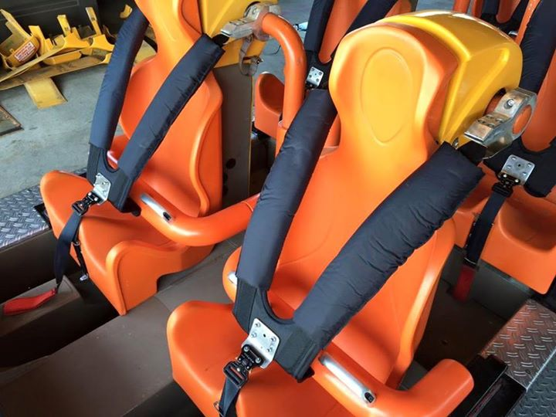
Making a Coherent Argument is like… | …Taking your Reader on a Rollercoaster
Claim/reason: Stating your opinion | Sitting them in the rollercoaster
Evidence: Giving a fact to support your opinion “for example” | Putting on one strap
Reasoning: Connecting your evidence back to your claim | Putting on the other strap
Image from coasterbuzz.com
Notes:
For this explanation—I recommend being physical and visual. I’ve even demonstrated this with a backpack for maximum visual.
Copyright © 2018 Jeanne Wolz, www.teacheroffduty.com. For classroom use only by a single teacher. Please purchase one licensure per teacher using this product. All rights reserved.

Slide 26
Making a Coherent Argument is like… | …Taking your Reader on a Rollercoaster
Claim/reason: Stating your opinion | Sitting them in the rollercoaster
Evidence: Giving a fact to support your opinion “for example” | Putting on one strap
Reasoning: Connecting your evidence back to your claim | Putting on the other strap
What happens to
your reader if
you forget to
“strap them in?”
What happens to
your reader if
you forget to
“strap them in?”
Image from coasterbuzz.com
Notes:
For this explanation—I recommend being physical and visual. I’ve even demonstrated this with a backpack for maximum visual.
Copyright © 2018 Jeanne Wolz, www.teacheroffduty.com. For classroom use only by a single teacher. Please purchase one licensure per teacher using this product. All rights reserved.

Slide 27
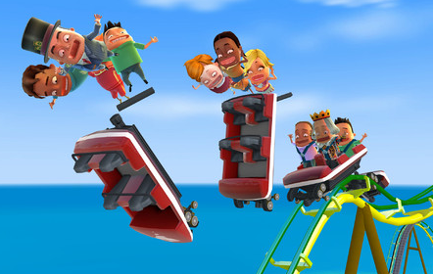
Making a Coherent Argument is like… | …Taking your Reader on a Rollercoaster
Claim/reason: Stating your opinion | Sitting them in the rollercoaster
Evidence: Giving a fact to support your opinion “for example” | Putting on one strap
Reasoning: Connecting your evidence back to your claim | Putting on the other strap
What happens to
your reader if
you forget to
“strap them in?”
What happens to
your reader if
you forget to
“strap them in?”
Image from appsaga.com
Image from coasterbuzz.com
Notes:
For this explanation—I recommend being physical and visual. I’ve even demonstrated this with a backpack for maximum visual.
Copyright © 2018 Jeanne Wolz, www.teacheroffduty.com. For classroom use only by a single teacher. Please purchase one licensure per teacher using this product. All rights reserved.

Slide 28
Share-Time Today
Tell the person next to you:
What’s the difference between claims, evidence, and reasoning?
Notes:
Copyright © 2018 Jeanne Wolz, www.teacheroffduty.com. For classroom use only by a single teacher. Please purchase one licensure per teacher using this product. All rights reserved.

Slide 29
Independent Reading
Grab an article in
your folder
and read it.

Slide 30
Write Wednesday
Reading Response:
Reflecting on the pros and cons that you just read, do you think that playing Fortnite every day is benefitting students, or do you think it is detrimental to students? Write a introduction and one paragraph response* to explain your thinking. Be sure to include a lead, background information and a thesis/claim in your introduction and textual evidence from the article to support your response. Start with stating your opinion then write your response.
*8-10 sentences

Slide 31
Write Wednesday
Reading Response:
Reflecting on the pros and cons that you just read, do you think that playing Fortnite every day is benefitting students, or do you think it is detrimental to students? Write a full paragraph response* to explain your thinking. Be sure to include textual evidence from the article to support your response. Start with stating your opinion then write your response.
*8-10 sentences

Slide 32
Independent Reading
10 minutes

Slide 33
WORK PERIOD
Complete the graphic organizer for the Fortnite article. (Just the T-chart)
READ “America the Not So Beautiful” in your textbook
Answer questions 1-8 (Homework)

Slide 34
Group work
Per your card compose the following:
Claim and thesis
Topic sentence
Evidence
Bridge
Conclusion sentence

